Slide 1
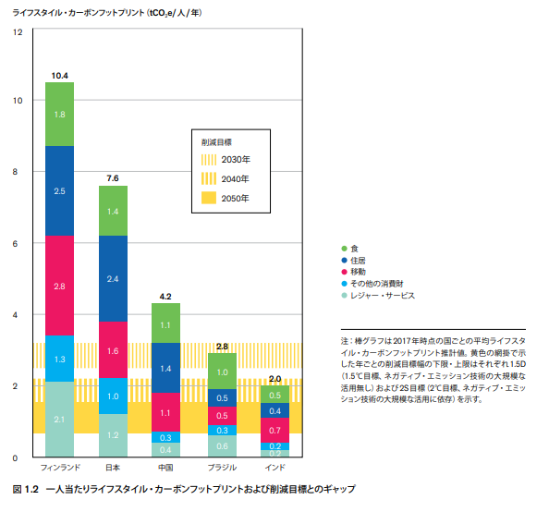
Life Style carbon footprint
Include indirect emission
(ex. Production of goods)
Direct emission from individual household
186Mt(GHG from total household)/126.8M(population)=1.47 Mt

Slide 2
Categories of Plastics and related Products
Source: ‘Mission Possible, sectoral focus Plastics’,Energy Transitions Commission
http://www.energy-transitions.org/sites/default/files/ETC%20sectoral%20focus%20-%20Plastics_final.pdf

Slide 3
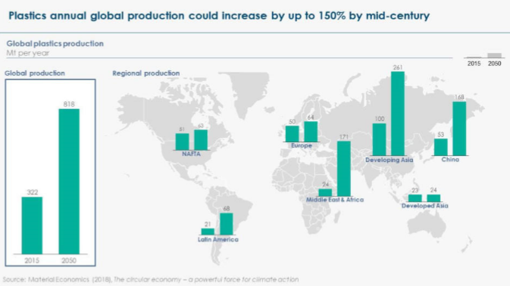
Plastics Demand Trends
Annual consumption
100kg/a.c
139kg/a.c
Asia(Japan excluded)
16kg/a.c
36kg/a.c
Benefits of plastic:
・Safer food delivery
・Comfortable interior
・and much more
Environmental benefit:
・food waste reduction
・Lighter vehicle bodies
Source: ‘Mission Possible, sectoral focus Plastics’,Energy Transitions Commission
http://www.energy-transitions.org/sites/default/files/ETC%20sectoral%20focus%20-%20Plastics_final.pdf

Slide 4
CO2 Emissions in of Production and End of Life
Current production
・300Mt
Future production (2050):
・800Mt
CO2 emission from production grows by more than 2.6 times
Source: ‘Mission Possible, sectoral focus Plastics’,Energy Transitions Commission
http://www.energy-transitions.org/sites/default/files/ETC%20sectoral%20focus%20-%20Plastics_final.pdf

Slide 5
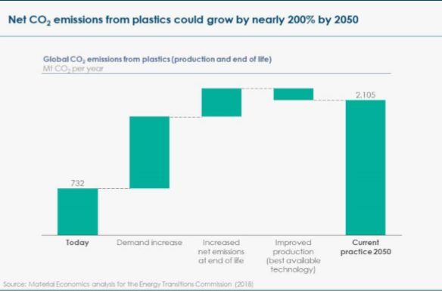
Estimation of future CO2 Emissions from plastic production
If no reduction strategy, CO2 emission from plastics could be responsible for 16% of total 2050 emissions, which are compatible with Paris objective of well below 2℃。
Source: ‘Mission Possible, sectoral focus Plastics’,Energy Transitions Commission
http://www.energy-transitions.org/sites/default/files/ETC%20sectoral%20focus%20-%20Plastics_final.pdf

Slide 6
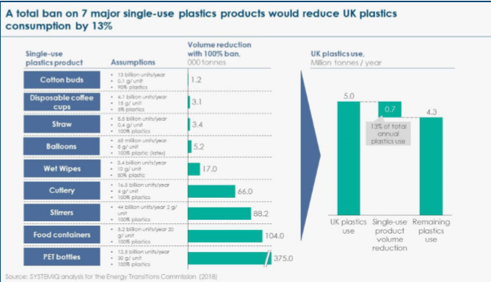
Plastic reduction effect of Single-use Plastics Van
Benefits of plastic:
・Safer food delivery
・Comfortable interior
・and much more
Environmental benefit:
・food waste reduction
・Lighter vehicle bodies
Source: ‘Mission Possible, sectoral focus Plastics’,Energy Transitions Commission
http://www.energy-transitions.org/sites/default/files/ETC%20sectoral%20focus%20-%20Plastics_final.pdf

Slide 7
Plastic Recycle_Chemical & Thermal
Showa Denko KPR/Plastics to Ammonia
Ammonium synthesis
gasification
NH₃
CO + H₂ + other
Plastic waste
https://www.sdk.co.jp/kpr/process.html

Slide 8
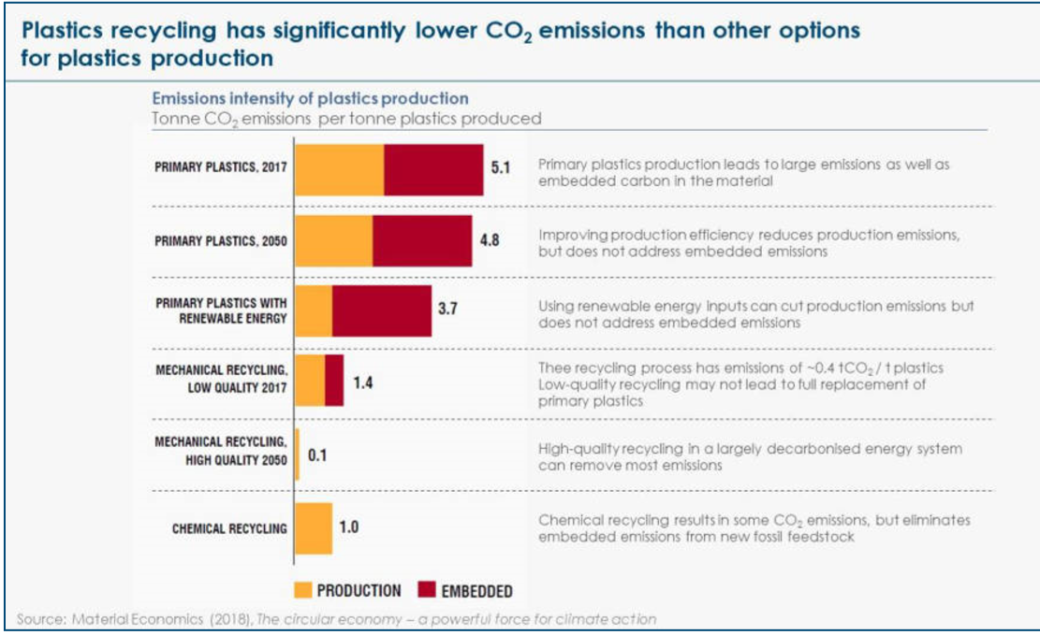
Plastic Recycle_CO2 reduction effect l
2.5
2.7
If burn used plastic,
Embedded C will be CO2
If embedded C is used,
CO2 never be emitted
Source: ‘Mission Possible, sectoral focus Plastics’,Energy Transitions Commission
http://www.energy-transitions.org/sites/default/files/ETC%20sectoral%20focus%20-%20Plastics_final.pdf

