Slide 1
What is the core of Micro-plastic problem?
Biodegradable plastic will leave some issues that cannot be solved.
This paper is quoted mainly from the commentary of Professional Engineer, Mr. Seiichi Hayashi.
出典： 技術士2020.4 技術解説 マイクロプラスチック問題 林 誠一

Slide 2
Index
Figure Roadmap of Ocean biodegradable plastic development and introduction
1. Introduction of micro plastics
1.1 Definition of micro plastic
1.2 Types and sources of micro plastics
1.3 Sources
2. What is the problem
2.1 Circumstances of each country
2.2 Chemical substances adsorbed on micro plastic
2.3 Additives
3. Existing efforts and issues
3.1 Recycling 3.2 Oxidized biodegradable plastic 3.3 Bioplastic, biodegradable plastic 3.5 New plastic
3.4 Issues of biodegradable plastic
4. Finally
Appendix -1, 2

Slide 3
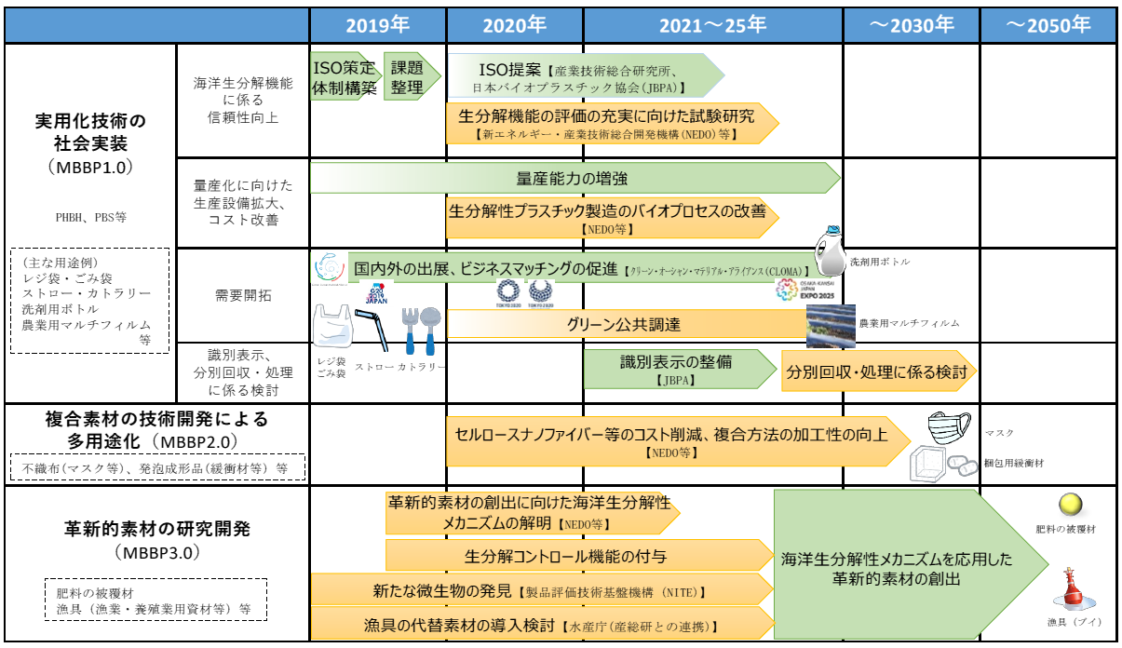
Roadmap of Ocean biodegradable plastic development and introduction

Slide 4
1. Introduction of micro plastics
More than 8.3 billion tons of plastics have been produced since 1950.
Of those, 6.3 billion tons have disposed as garbage.
It is expected to double by 2025 and more than triple by 2050.
Thermoplastic plastics account for about 90% and thermosetting plastics for about 10%.
Note; Thermoplastic plastics :熱可塑性、thermosetting plastics：熱硬化性
Thermoplastics consist of 32% polyethylene (PE),
23% polypropylene (PP), 16% polyvinyl chloride (PVC),
7% polyester (PET), 7% polystyrene / foamed polystyrene (PS / EPS).

Slide 5
1.1 Definition of micro plastic - 1
Micro plastics are small plastics whose size is not officially defined, but often refers to plastic particles less than 5 mm in size.
The unit of micro-plastic is μm (micrometer) is 10⁻⁶m.
In actual micro-plastics, there are even smaller nanometers (10⁻⁹m ) in size (also called nano-plastics) than micros.
These are not visible and can only be confirmed with an electron microscope.

Slide 6
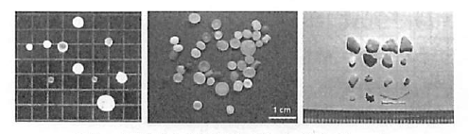
1.1 Definition of micro plastic - 2
Primary micro plastic
Micro beads Resin pellets
for scrub material for plastic
(0.001mm to 0.1mm) (0.5mm)
Secondary micro plastic
0.5mm to 10⁻⁹ m(nano-m)

Slide 7
1.2 Types and sources of micro plastics （１） Primary micro plastic (small from the origin)
For the purpose of use as a product or product raw material.
A plastic is intentionally manufactured in a small size.
１）These small beads are added to cosmetics such as facial cleansers, body wash, toothpaste, etc. for the purpose of removing skin stains and old keratin. It is a so-called scrubber or abrasives.
Outflow of beads that cannot be caught in sewage treatment is the main cause, and intentional primary micro plastic production accounts for less than 0.1% of total plastic production.
２） Resin pellets are raw materials for plastic products.

Slide 8
1.2 Types and sources of micro plastics (2) Secondary micro plastic
Secondary micro plastic is a fragment of micro plastic that has become smaller due to abrasion and deterioration of the originally large plastic product in the natural environment.
Plastics products such as bottles, plastic bags and fishing gear spilled into the ocean are exposed to waves and ultraviolet light and become micro plastics.
The outflow of plastic waste from land to sea is said to be 8 million tons per year.
The number of micro plastics per unit area in the ocean is by far the largest in the East Asian seas including Japan, and is about 16 times the world sea.

Slide 9
1.3 Sources
Sources of micro plastics in general rivers include:
(1) Land-based spills from sources, such as tyre rubber, polymers used to reinforce asphalt pavement on roads
(2) Micro plastic particles derived from thermoplastic plastics are used for marking paints such as ｒoad signs, etc.
(3) Artificial turf, urban dust, and dust from plastic fiber due to abrasion by tearing and washing.
(4) Agricultural effluent from the use of sludge and drainage
(eg Synthetic fibers, washing clothes, microbeads for cosmetics, overflow in sewers, erosion or deterioration of plastic parts in treatment plants)
(5) Micro plastics as a result of daily household wear such as cutlery, toothbrush, cup

Slide 10
2. What is the problem 2.1 Circumstances of each country
Micro plastic contamination extends not only from underwater but also into the air and our food.
Snow falling in the Arctic contains micro plastic and rubber particles, according to a study by a joint research team in Germany and Switzerland.
90% of the world's salt contains micro plastics by a joint research team of Korean researchers and an environmental protection group "Greenpeace East Asia".
In March 2018, the British government issued a report warning that plastic waste in the waters would triple in 10 years if measures to reduce waste entering the sea were to be taken.

Slide 11
2.2 Chemical substances adsorbed on micro plastic
Adsorption of harmful substances on micro plastic
Micro plastics have the property of easily adsorbing persistent organic pollutants (POPs) such as PCBs on the surface. In fact, there have been reports of cases where harmful substances such as PCBs were detected in micro plastics collected offshore in Japan at concentrations higher than those in seawater.
The following possibilities of food chain have also been pointed out. Living organisms eat micro plastics with such harmful substances attached. In addition, harmful substances accumulate from plankton to fish and to us humans.
There is no exception in Japan. PCBs, which had been sleeping quietly on the sea floor of Tokyo Bay, stick to micro plastic and accumulate again in living organisms.

Slide 12
2.2 Chemical substances adsorbed on micro plastic
(2) Influence of micro plastic
The biggest factor is that marine life consumes micro plastics. Many cases of accidental ingestion of micro plastics by fish, shellfish, crustaceans, etc. in the ocean have been reported.
Micro plastics are not digested in the body. If the particle size is very small, they will be released out of the body. However, if the particle size is somewhat large, the digestive tract will be blocked, and in the worst case, the individual organisms will die.
It has been reported that not only seafood but also zooplankton are affected by micro plastic. Influences such as impairment of lipid metabolism due to ingestion of micro plastic have been confirmed.

Slide 13
2.3 Additives
It is easy to process when manufacturing plastics. Many kinds of harmful additives are added for the purpose of stabilization, etc., but they may melt out of the micro plastic.
Examples of additives are listed below. ①Stabilizers for polymers ：prevention of polymer oxidation and deterioration by ultraviolet rays, such as antioxidants (phosphites, phenols, thioethers, metal salts) and ultraviolet absorbers (bensotriazoles. Triazines, etc.)
②Function-imparting agents (plasticity, flame retardancy; compatibilization, transparency, activity enhancement, etc.) For example, plasticizers (phthalic acid type, polyester type, epoxy type, etc.) and flame retardants (intmescent type, phosphate ester type, Halogen-based, inorganic-based, etc.), compatibilizers, clarifiers, permanent antistatic agents, lubricity improvers, etc.

Slide 14
2.3 Additives
Not all chemicals used here are harmful. However, the flame retardant polybrominated biphenyls (PBDEs) used in polystyrene and polypropylene, and the phthalic acid esters used as plasticizers for polyvinyl chloride (DOP, etc., 20 to 30 types, used in 10 to 40% of the weight) are harmful or suspicious chemicals.

Slide 15
3. Existing efforts and issues 3.1 Recycling - 1
“Thermal recovery" or “Heat recovery“
Thermal recovery is not regarded as recycling.
Because it dose not reduce greenhouse gas emissions.
2) Removal of waste and chemicals
WH0 says that more than 90% of micro plastics can be removed by appropriate sewage treatment, such as the removal of waste and chemicals.
3) 3R
The basis for solving the plastic waste problem is the so-called 3R.
・ Reduce, Reuse, Recycle

Slide 16
3. Existing efforts and issues 3.1 Recycling - 2
Therefore, for example, thorough elimination of free shopping bags or cessation of disposable plastic products (payment, material conversion, reuse, and reformation of mindset) can lead to a reduction in plastics flowing into the sea.
In Japan, in particular, where plastic production is large, it is important that production and use be reduced. Particularly in Japan, the most effective reduction can be promoted by eliminating plastics such as containers and packaging that are mainly disposable, which accounts for about half of waste plastics (by stopping single use or converting packaging to non-plastic material).

Slide 17
3.2 Oxidized biodegradable plastic
Conventional petroleum-derived plastics (for example, polyethylene and polypropylene) with an additive (prodegradant) that promotes oxidation are called oxidized biodegradable plastics.
It gives the impression that plastic products are going away quickly, but the resulting micro plastics are no different from conventional micro plastics.
The ban on disposable plastics passed by the EU Parliament in 2018 has banned oxidized biodegradable plastics.

Slide 18
3.3 bioplastic, biodegradable plastic
The transition to the use of bioplastics, ie, biomass plastics, biodegradable plastics, or paper can be considered.
For these. Is there really no impact on the environment? Careful consideration should be given to whether a transition to alternatives is possible.

Slide 19
3.4 Issues of biodegradable plastic -1
The time required for disassembly cannot be controlled.
The Ministry of Economy, Trade and Industry will promote the development, introduction and dissemination of marine biodegradable plastics, not decay. A roadmap was created to summarize the measures, and the aim is to develop a marine biodegradable plastic with a switch function.
2. Biodegradable plastic does not always degrade in the sea.
For example, polylactic acid (PLA) is not degraded in the marine environment because biodegradation requires temperatures above 50 °C.
3. Because the planted area is limited, it is difficult to obtain a large amount of raw materials which is mainly starch.
4. Cost is more expensive than regular plastic
Because the raw material is not cheap petroleum products and the sales volume is small, it is 4 to 5 times higher.

Slide 20
3.4 Issues of biodegradable plastic -2
Since the 1990s, plastics made from corn and sugar cane have been put into practical use. This plastic was not popular due to its high production cost and difficulty in molding.
5. Compared to conventional plastics, products with a long product life are inferior in terms of durability in terms of biodegradability.
6. The types and densities of microorganisms that inhabit depend on the environment. So the types of plastics that are easily degraded are different.
7. Since biodegradable plastics are finally decomposed into C02 and water by the action of microorganisms, C02 is generated in the same way as combustion.
8. Biodegradable plastics are exonerated because they return to nature, and there is a tendency to tolerate disposable products.
9. Harmful additives remain (additional additives are needed to stabilize biodegradable plastics as well as or more than normal plastics).

Slide 21
3.5 New plastics
1. Professor Iwata, Group of the University of Tokyo has developed a new plastic. It is a polylactic acid film that is a biodegradable plastic encapsulating enzyme that can be decomposed anytime and anywhere, and has the function of starting decomposition immediately after use.
2. The raw material for plastics is the residue after making butter and cheese, so it can be procured cheaply. By MCHC
3. Sumitomo Chemical and Sekisui Chemical produce plastic raw materials using household combustible waste.

Slide 22
4 Finally
Isn't it now time to bring together the wisdom of mankind in order to protect the irreplaceably beautiful environment of the earth and to not ruin the animals and plants that coexist there?
In today's world, it is impossible to use no plastic, so use it as little as possible and recycle it if you use it.
It will be necessary to convert it to a material that quickly decomposes into something harmless in the natural environment.

Slide 23
Appendix – 1 Edible food container
Munch Bowl
Ingredients
Wheat flour (47%), Wheat Bran (16%), Plant Oil (Canola), Sugar, Salt, Rooibos Extract Allergens: Gluten (Wheat)
Shelf life: 15 months - Store sealed in a cool dry place
The preservative of Munch bowl is Rooibos.
This ball can hold food for 5 hours
Reporter tasting Munch Bowl
Source ： CNN ENGLISH EXPRESS March 2020 Edible Ecofriendliness

Slide 24
Appendix – 1 Edible food container
Munch Bowl
Munch bowl is palm size (Left)
Sweet flavored munch bowl looks good on fruits and ice cream (Right)

Slide 25
Appendix – 2 A solution to the shopping bag problem on TV broadcasting
Embarrassing shopping bag

