Slide 1
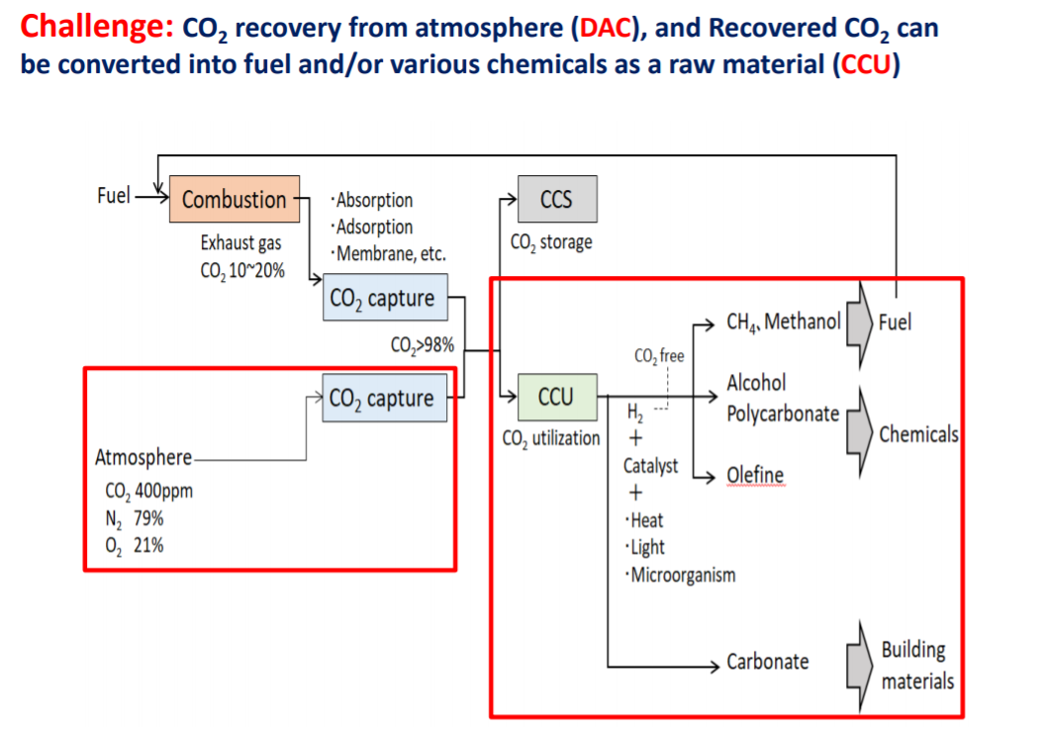
Carbon Capture Storage & Utilization
山地憲治 CCUS実用化への展望と課題、革新的CO2分離回収技術シンポジウム資料 2020

Slide 2
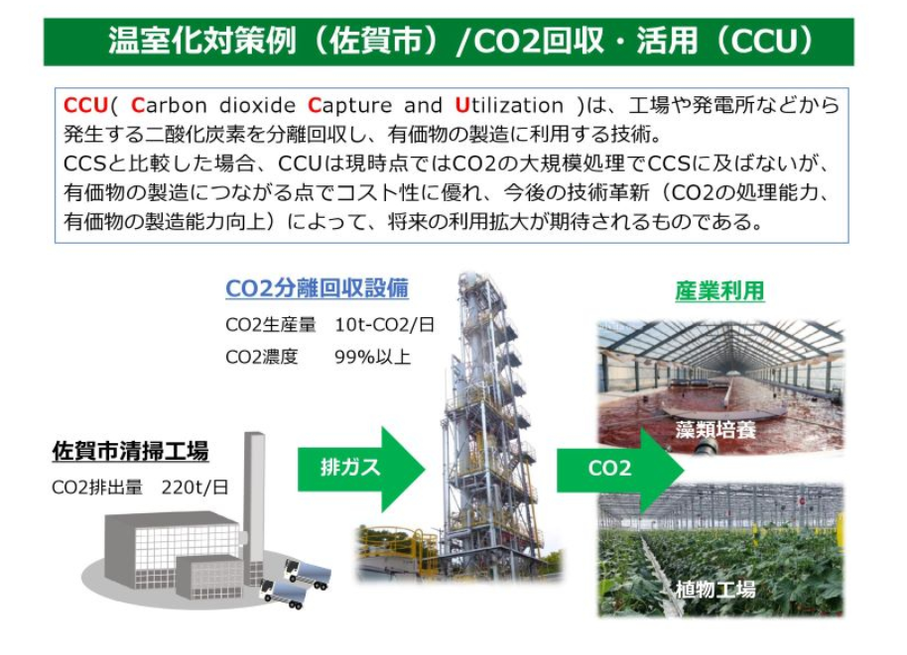
Example of CCU
Source: Ministry of Environment

Slide 3
Example of CCU
Source: Ministry of Environment http://www.env.go.jp/earth/ccs/ccus-kaigi/2-4_1_CCUS_Utilization_Hitz.pdf

Slide 4
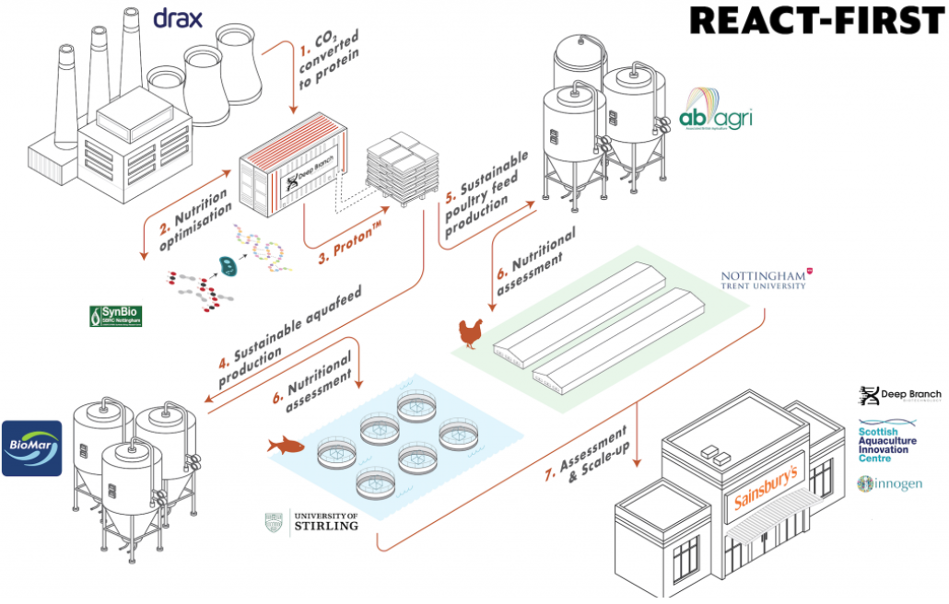
Example of CCU
UK power generation company
https://www.drax.com/press_release/ground-breaking-carbon-recycling-project-launches-with-3million-innovate-uk-funding/

